Slide 1
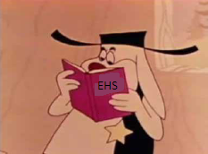
Safety Focus for Students
Bob May
EHS&Q Deputy

Slide 2
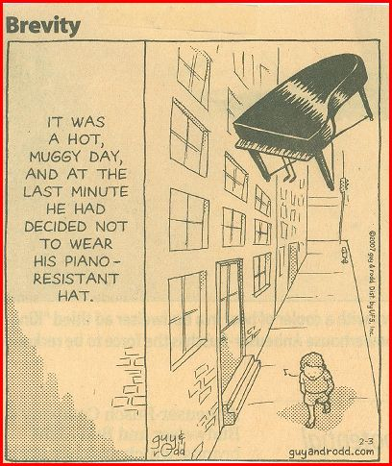

Slide 3
Topics
Situational Awareness
What can you expect?
Reporting
Equipment Use
Material Handling
Electrical Safety Reminders
Heat Stress
Where do most of our “bad day” events occur?
Bad day event example
Summary

Slide 4
Situational Awareness
Wherever you go in the lab, it is your responsibility to understand:
Fire exits, alarms, evacuation conditions, muster points
E.g. how we handle bad weather events
Wherever you go in the lab, it is your responsibility to understand
The hazards associated with your work, work of those around you
How to mitigate those hazards
Engineered safeguards (
PPE (E. g. piano resistant hard hat)
Administrative controls (procedures and protocols)

Slide 5
What Can You Expect?
To read, understand, and act in accord with lab safety policy…
No activity is so urgent or important that we will compromise our standards for environment, safety, and health. (paraphrase of Lab Director’s statement)
Your work and your safety, as well as the work of those around you, depends on you
To have a JLab staff member who will help you get “connected” to your planned activities safely and efficiently
Training, work with another experienced person
To have a meaningful and educational time at JLab

Slide 6
Reporting
What you need to do:
Report First Aid events to your mentor or supervisor
Report Injuries to your mentor or supervisor
Report near misses to your mentor or supervisor
What the Lab will do:
Get you the help you need
Learn from your experience
Share
Get relevant Tool Box briefing material to you within one work-week

Slide 7
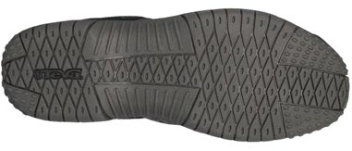
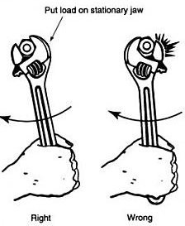
Equipment Use
Ladders
Check the label and rating, working order, and select
best height
Look at the step treads; then look at your own
work shoes: got a good match for traction?
Hand tools
Right tool for the job?
Improperly sized tools make work harder, not easier or safer
Good working order?
Includes tool handles and guards
Includes wheels, bits, blades
Do you know how to use it safely?
This includes tool orientation to the workpiece

Slide 8
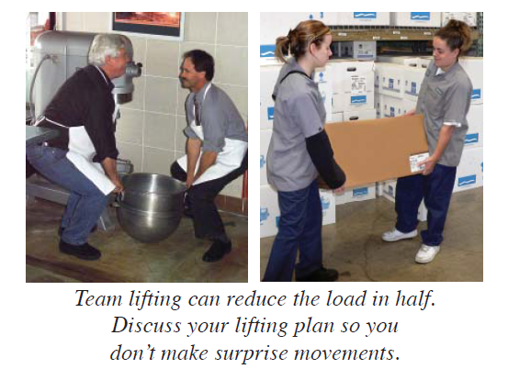
Manual Material Handling
MMH Problem areas:
Awkward postures (e.g., bending, twisting)
Repetitive motions (e.g., frequent reaching, lifting, carrying)
Forceful exertions (e.g., carrying or lifting heavy loads)
Pressure points (e.g., grasping [or contact from] loads, leaning against parts or surfaces that are hard or have sharp edges)
Static postures (e.g., maintaining fixed positions for a long time)
Use Team Lift: Try to find a coworker of roughly same height to help with lift

Slide 9
Manual Material Handling, cont’d.
Plan the lift:
Wear appropriate shoes to avoid slips, trips, or falls
If you wear gloves, choose the size that fits properly
Depending on the material the gloves are made of more force may be needed to grasp and hold objects: a single pair of heat-resistant gloves can reduce your grip strength up to 40 percent
Lift only as much as you can safely handle by yourself
Keep the lifts in your power zone (i.e., above the knees, below the shoulders, and close to the body), if possible
Use extra caution when lifting loads that may be unstable

Slide 10
Manual Material Handling, cont’d.
When lifting:
Get a secure grip
Use both hands whenever possible
Avoid jerking by using smooth, even motions
Keep the load as close to the body as possible
To the extent feasible use your legs to push up and lift the load, not the upper body or back
Do not twist your body. Step to one side or the other to turn
Alternate heavy lifting or forceful exertion tasks with less physically demanding tasks
Take rest breaks

Slide 11
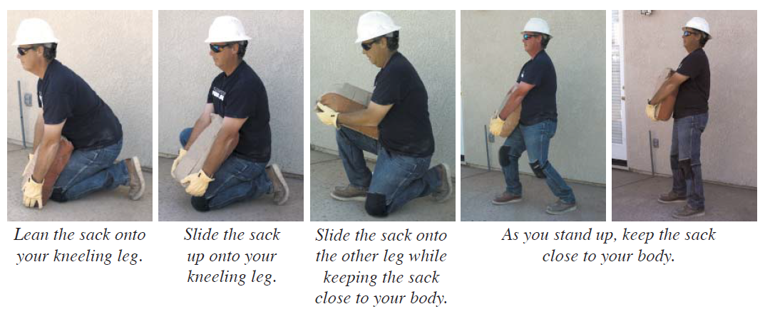
Manual Material Handling, cont’d.
Picking up a sack of ready-mix concrete:
A great example – flexible, can be powdery or slippery, weight at limit for unassisted pickup.

Slide 12
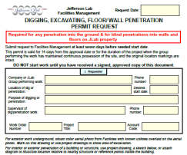
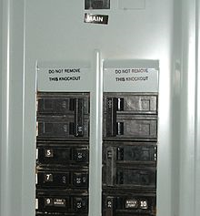
Electrical Safety Reminders
Don’t forget to:
Use GFCI protection with power tools
TEST for zero energy during a Lock/Tag/Try
Use the blind penetration permit system
Don appropriate electrical PPE
Maintain Arc Flash Boundaries
Refer any changes to breakers, breaker settings, fuse values to FM&L
Report missing breaker panel schedules to
FM&L

Slide 13
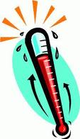
Heat Stress
SOTRs and selected individuals now get automatic pages when the Heat Stress Index goes above or drops below threshold values in the EH&S Manual
If you need access to this information, see Dick Owen
Elevated temperature may mean
Routine hydration – make it part of the work prep and plan
Work breaks in the shade/work indoors during hot part of day
Workplace measurements by IH to evaluate specific work areas
Webstock Bottled water: Vendor = FORSUP (Forms & Supply) Part# NLE101243 = 24 cnt
Webstock : SQWINCHER Vendor = GSSGRA (Grainger) Part# 1UKF(3,4,5,6) or 2EHF(2,3) = 50 cnt
Heat Index 104 – 115°F | DANGER Muscle Cramps, and/or Heat Exhaustion likely Heat Stroke probable for at-risk workers | Text page sent to Supervisor/SOTRs 104⁰F Implement Stage 3 Process Steps. Limitations of work activity are certain. | If remainder of work day is 2-hours or more.
Notes:
Bottled water: Vendor = FORSUP (Forms & Supply) Part# NLE101243 = 24 count of 0.5L bottled water SQWINCHER electrolyte replenishment for water bottles: Vendor = GSSGRA (Grainger) Part# 1UFK3 = 50 pack sugar free orange mix 1UFK4 = 50 pack sugar free fruit punch 1UFK5 = 50 pack sugar free mixed berry 1UFK6 = 50 pack sugar free lemonade 2EHF2 = 50 pack sugar free lemon-lime 2EHF3 = 50 pack sugar free grape Also anyone with a pcard could also purchase water from local grocery stores if more convenient. IH will keep approx 100 bottles of water sqwinchers onhand through the summer.

Slide 14
Where do most of our “bad day” events occur?
Changing work-flow
If it isn’t going like you planned, stop and reevaluate with coworker, supervisor, EHS&Q, etc.
If you encounter a new or unanticipated hazard, stop and reevaluate, etc.
Watch out for your co-worker
They may not thank you, but you can save them injury
Nothing we do is so important that we need to compromise our standards for safety

Slide 15
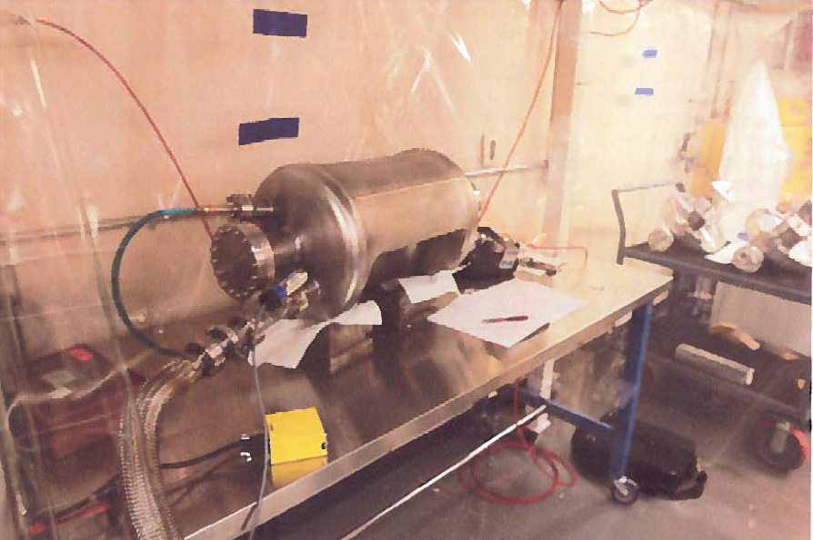
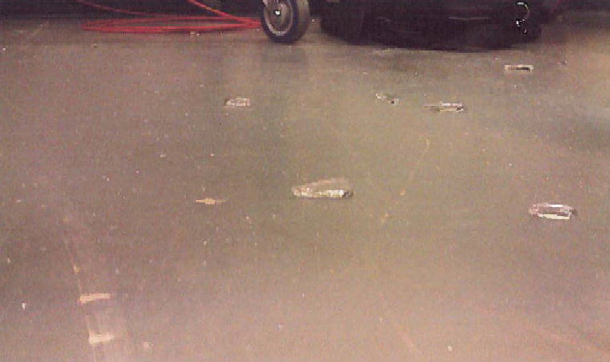
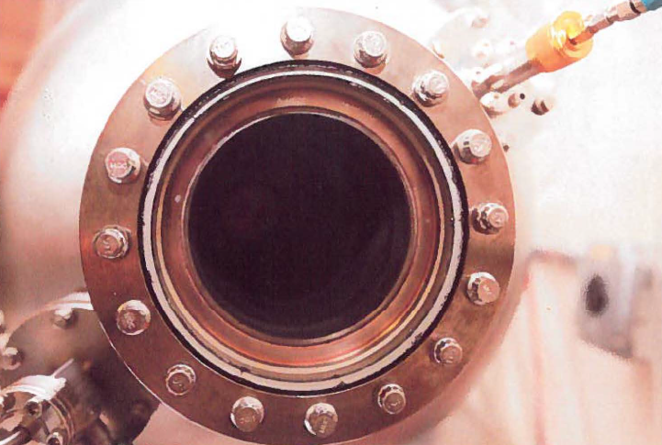
Bad day event example
ACC-12-0711 - Experimental RF Cavity Vacuum Window Failure (report date Aug. 12, 2012)
Student built assembly to mentor specifications; only a picture supplied by the manufacturer…
Student ignored suggestions from JLab staff.
Operated for the first time in front of mentor – failed by ejecting glass shards, minor injury, but… major near miss

Slide 16
Summary
We generally work very safe! This is good!
However, the way we treat ourselves and our tools in our workplace still results in incidents and injuries that are preventable and avoidable!
Theses injuries are typically to our extremities:
Fingers, Hands, Arms, Legs
Related to the way we handle equipment, position our bodies (extremities) and relate to hazards
Continuous questioning is key
Don’t let your work environment dictate safety outcomes
Modify your work environment and practices for safety

